Slide 1
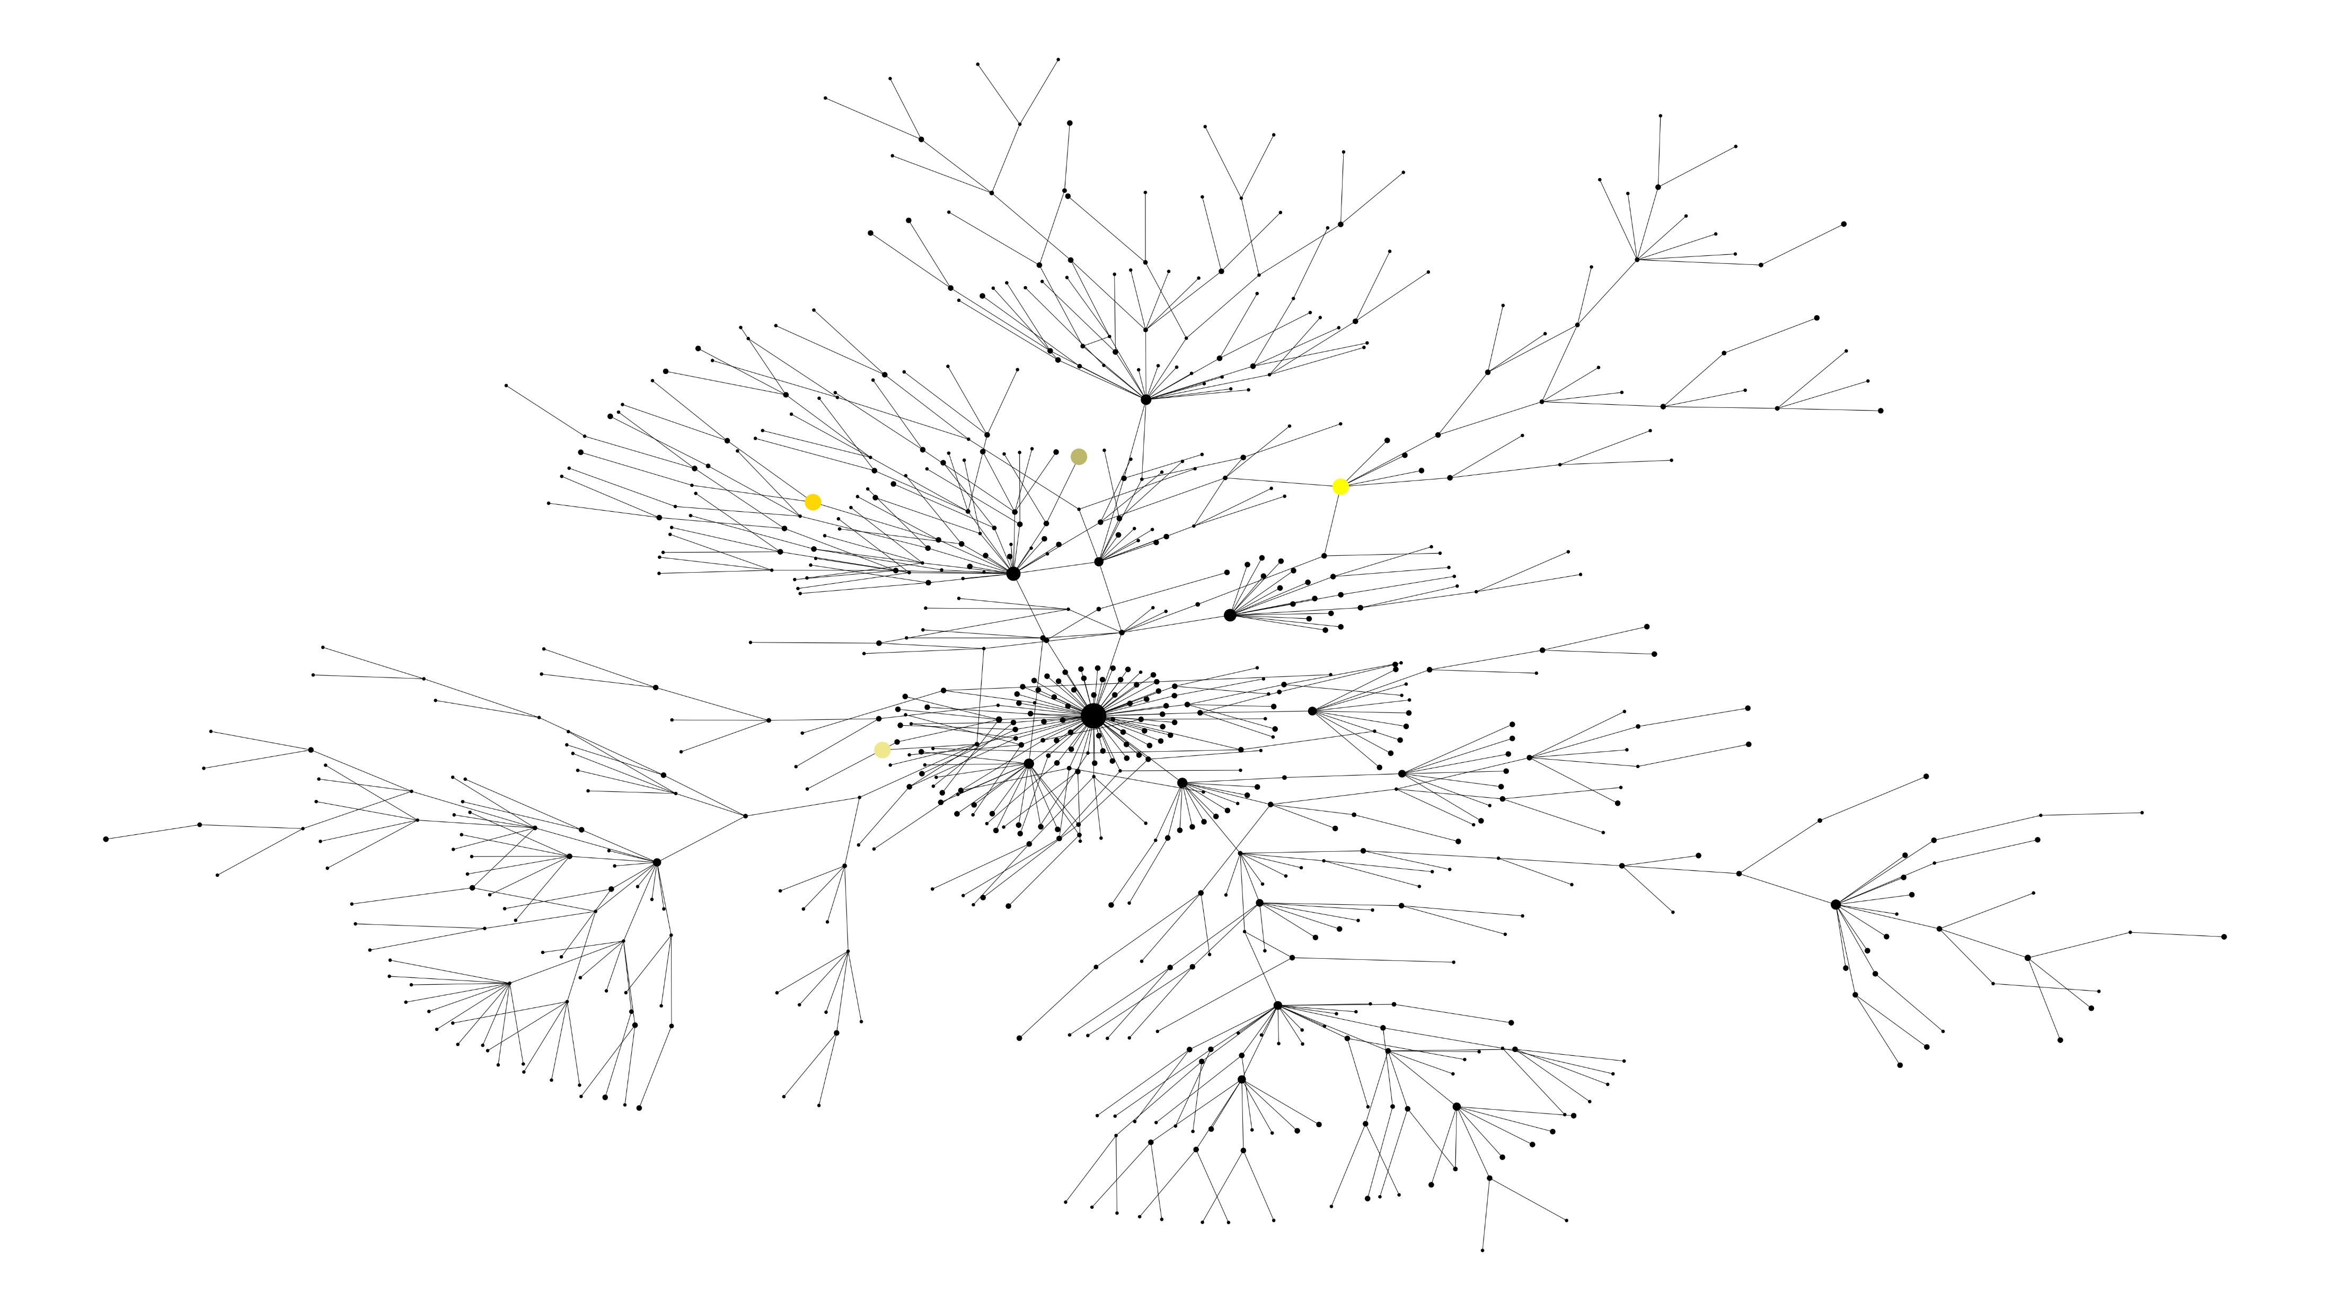
References
Reference UK Reference South Africa Ref Brazil Reference

Slide 2
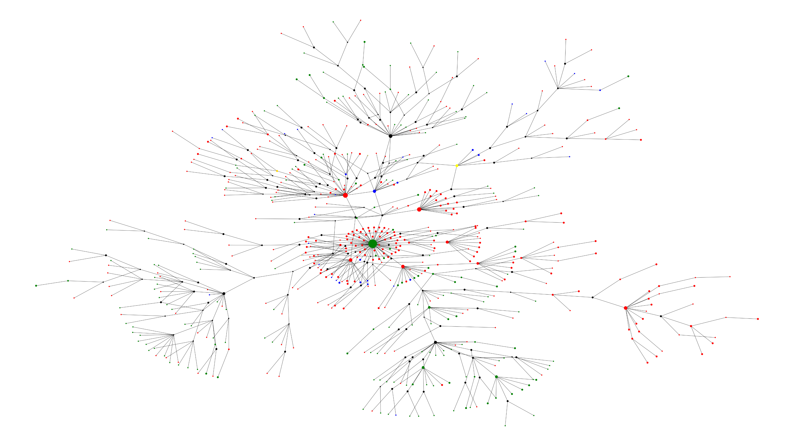
Symptom Graph
Symptomatic Asymptomatic Unknown Reference UK Reference South Africa Ref Brazil Reference

Slide 3
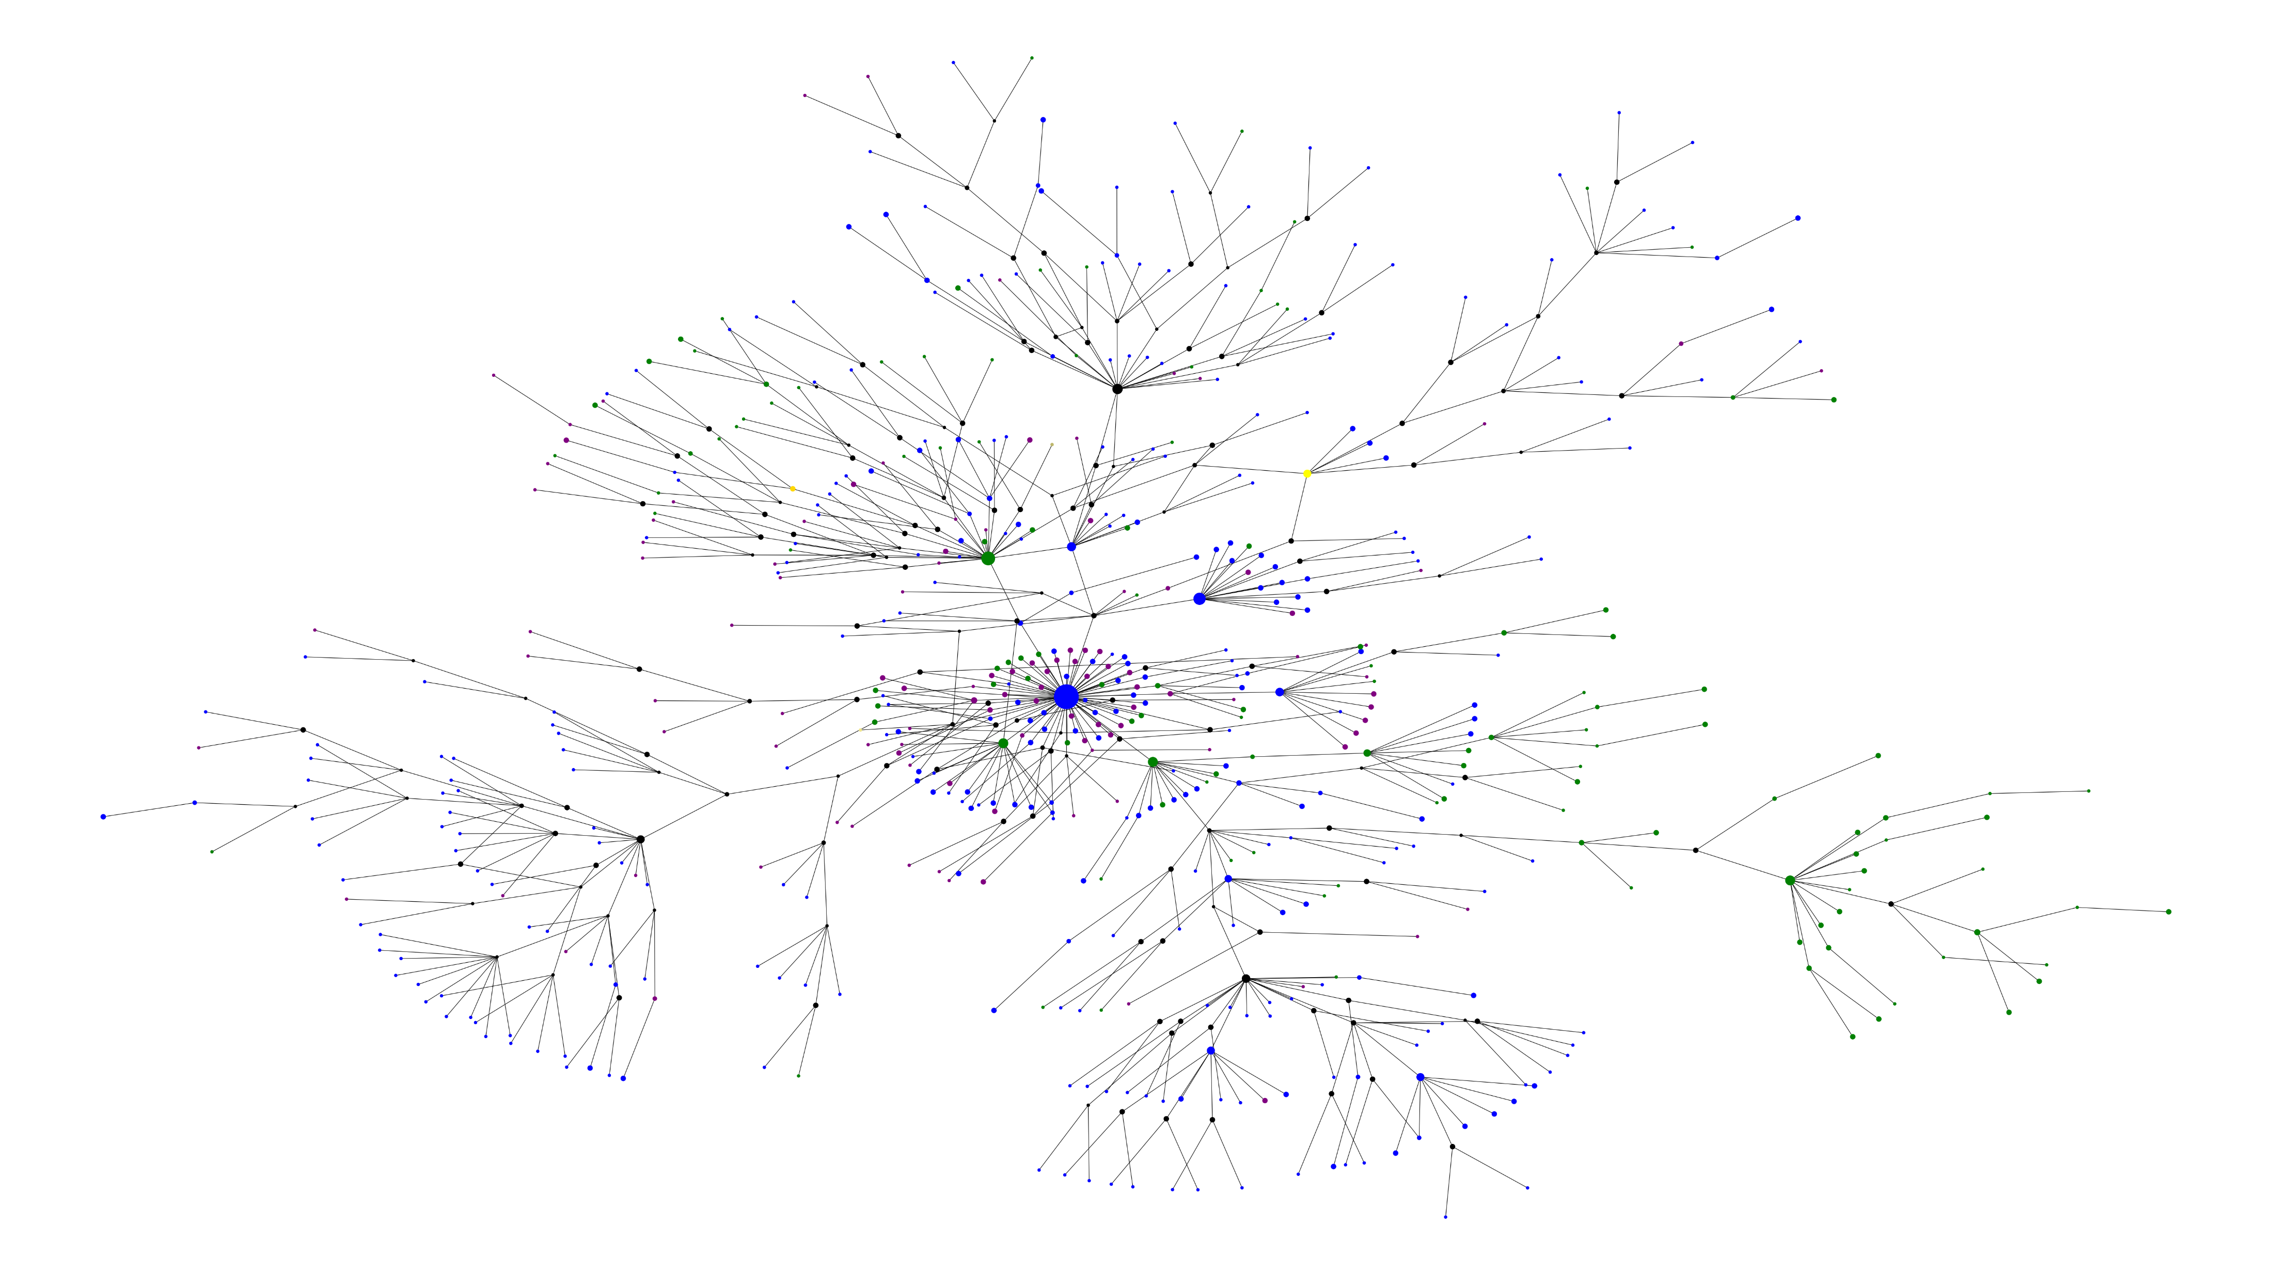
Outcome Graph
Alive Deceased Unknown Reference UK Reference South Africa Ref Brazil Reference

Slide 4
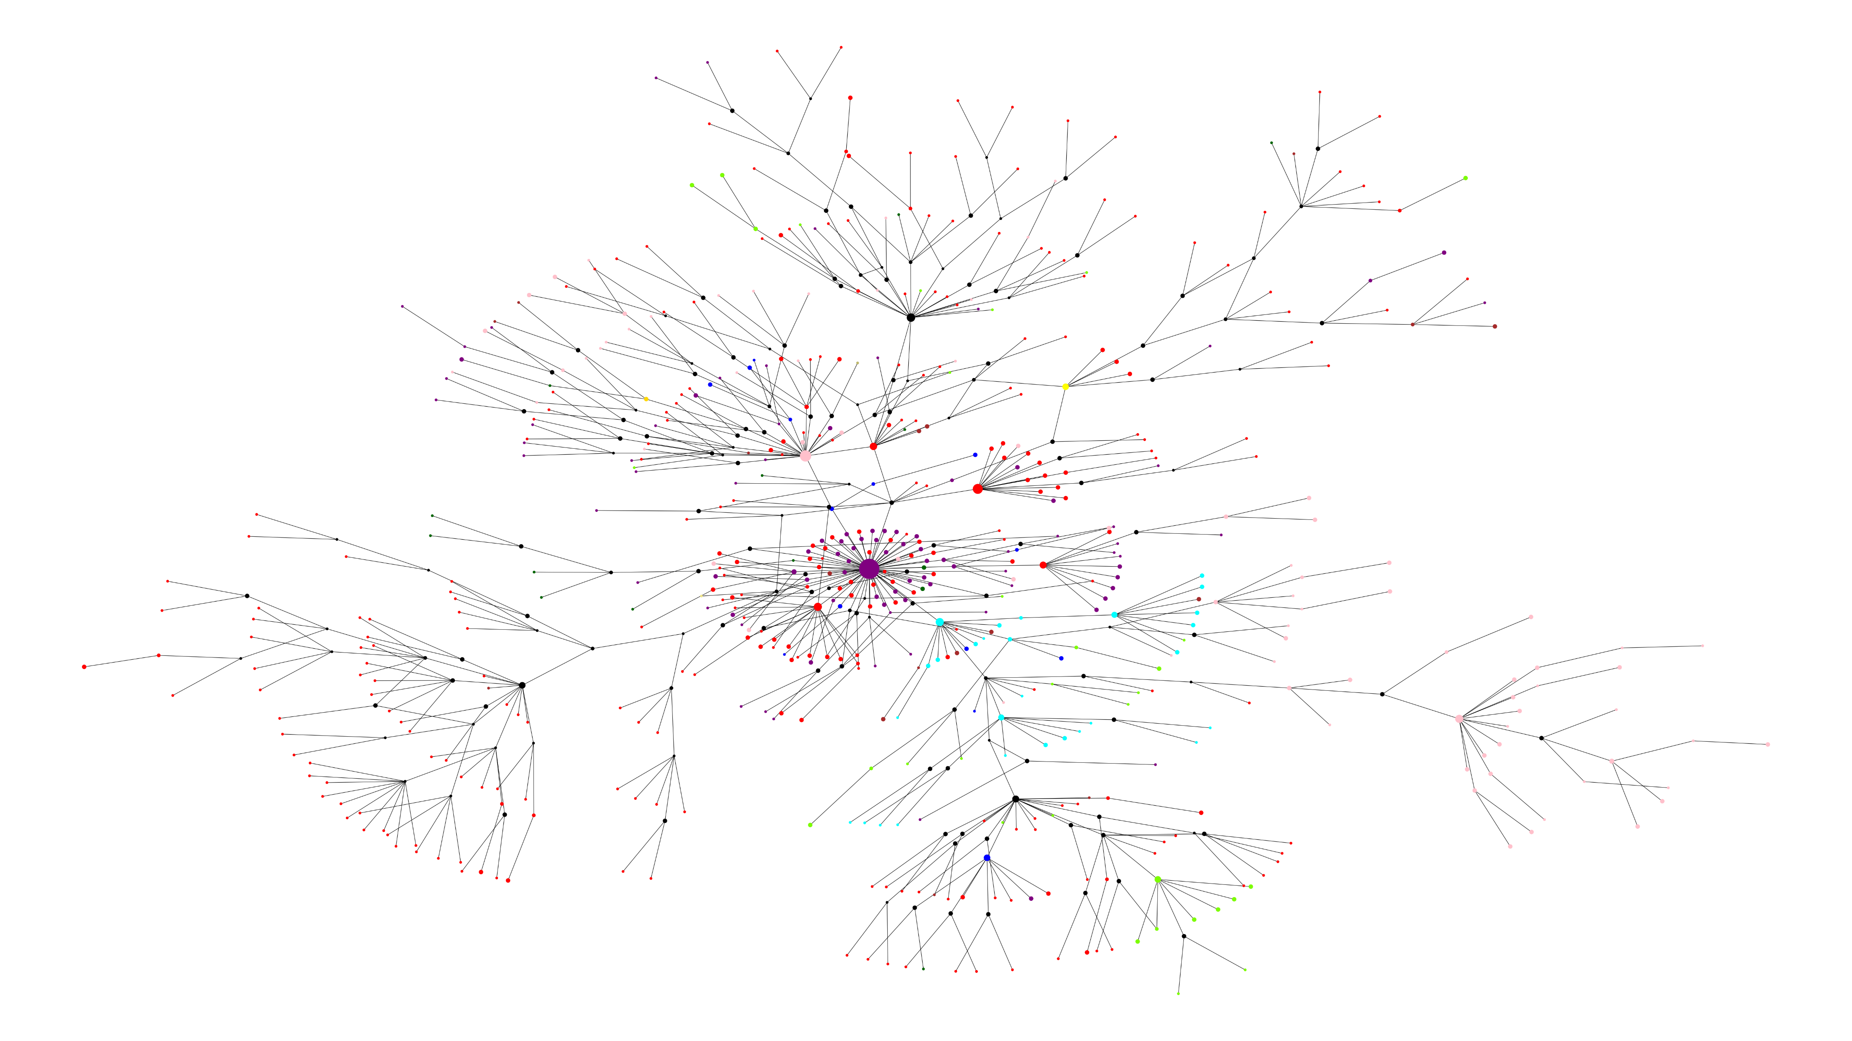
Location Graph
California Montana New York Puerto Rico South Carolina Louisiana Texas Other Reference UK Reference South Africa Ref Brazil Reference

Slide 5
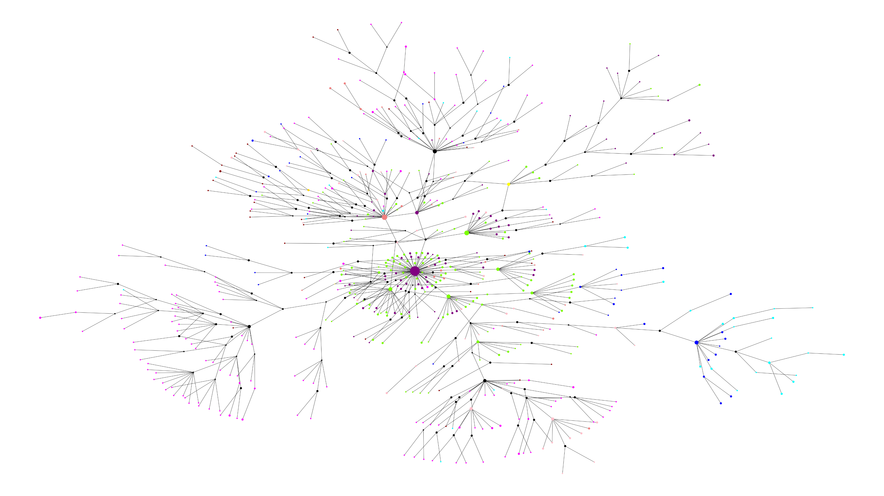
Dates Graph
February / March 2020 April 2020 May / June 2020 July 2020 August / September 2020 October / November 2020 December 2020 January / February 2021 Reference UK Reference South Africa Ref Brazil Reference

Slide 6
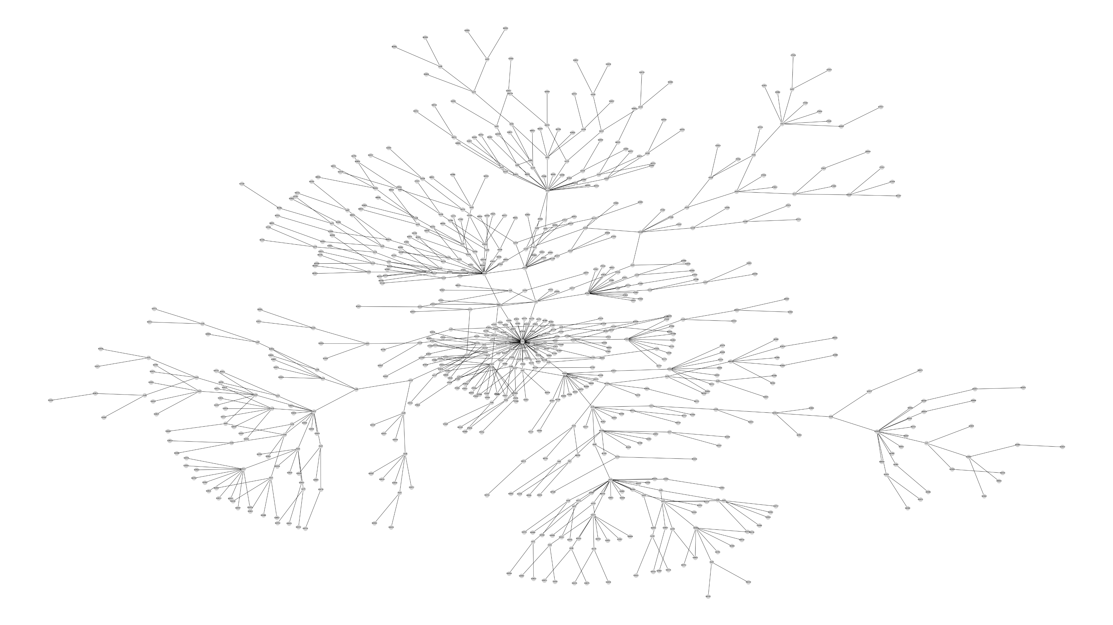
Names graph

Slide 7
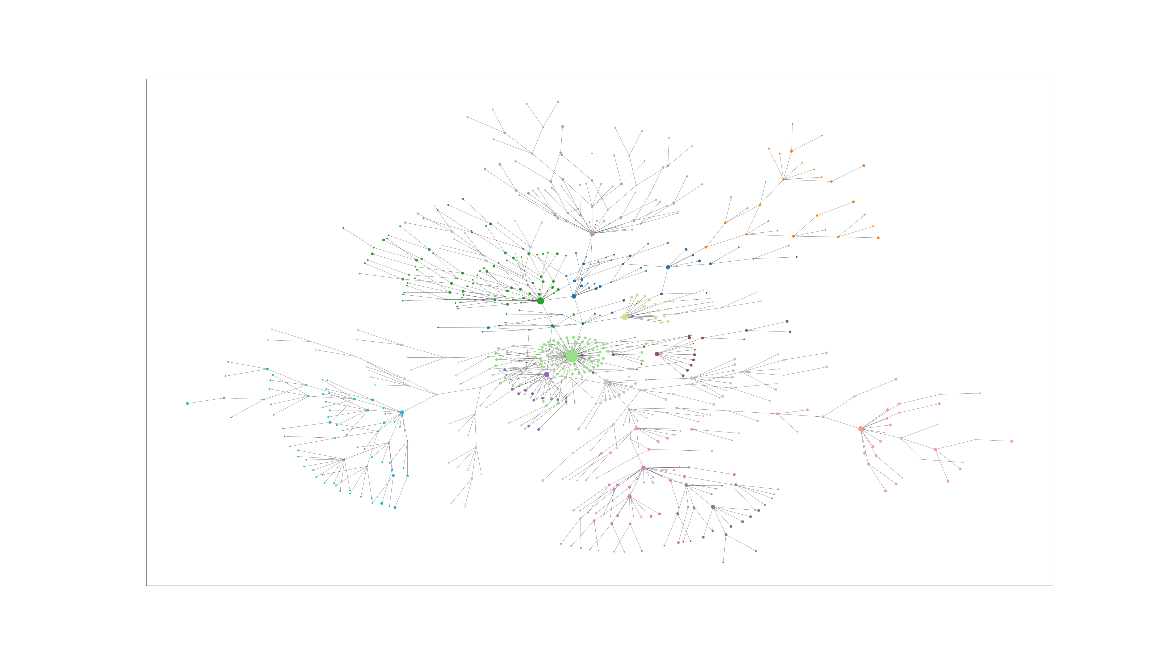
Community detection – Louvain 15 Clusters

Slide 8
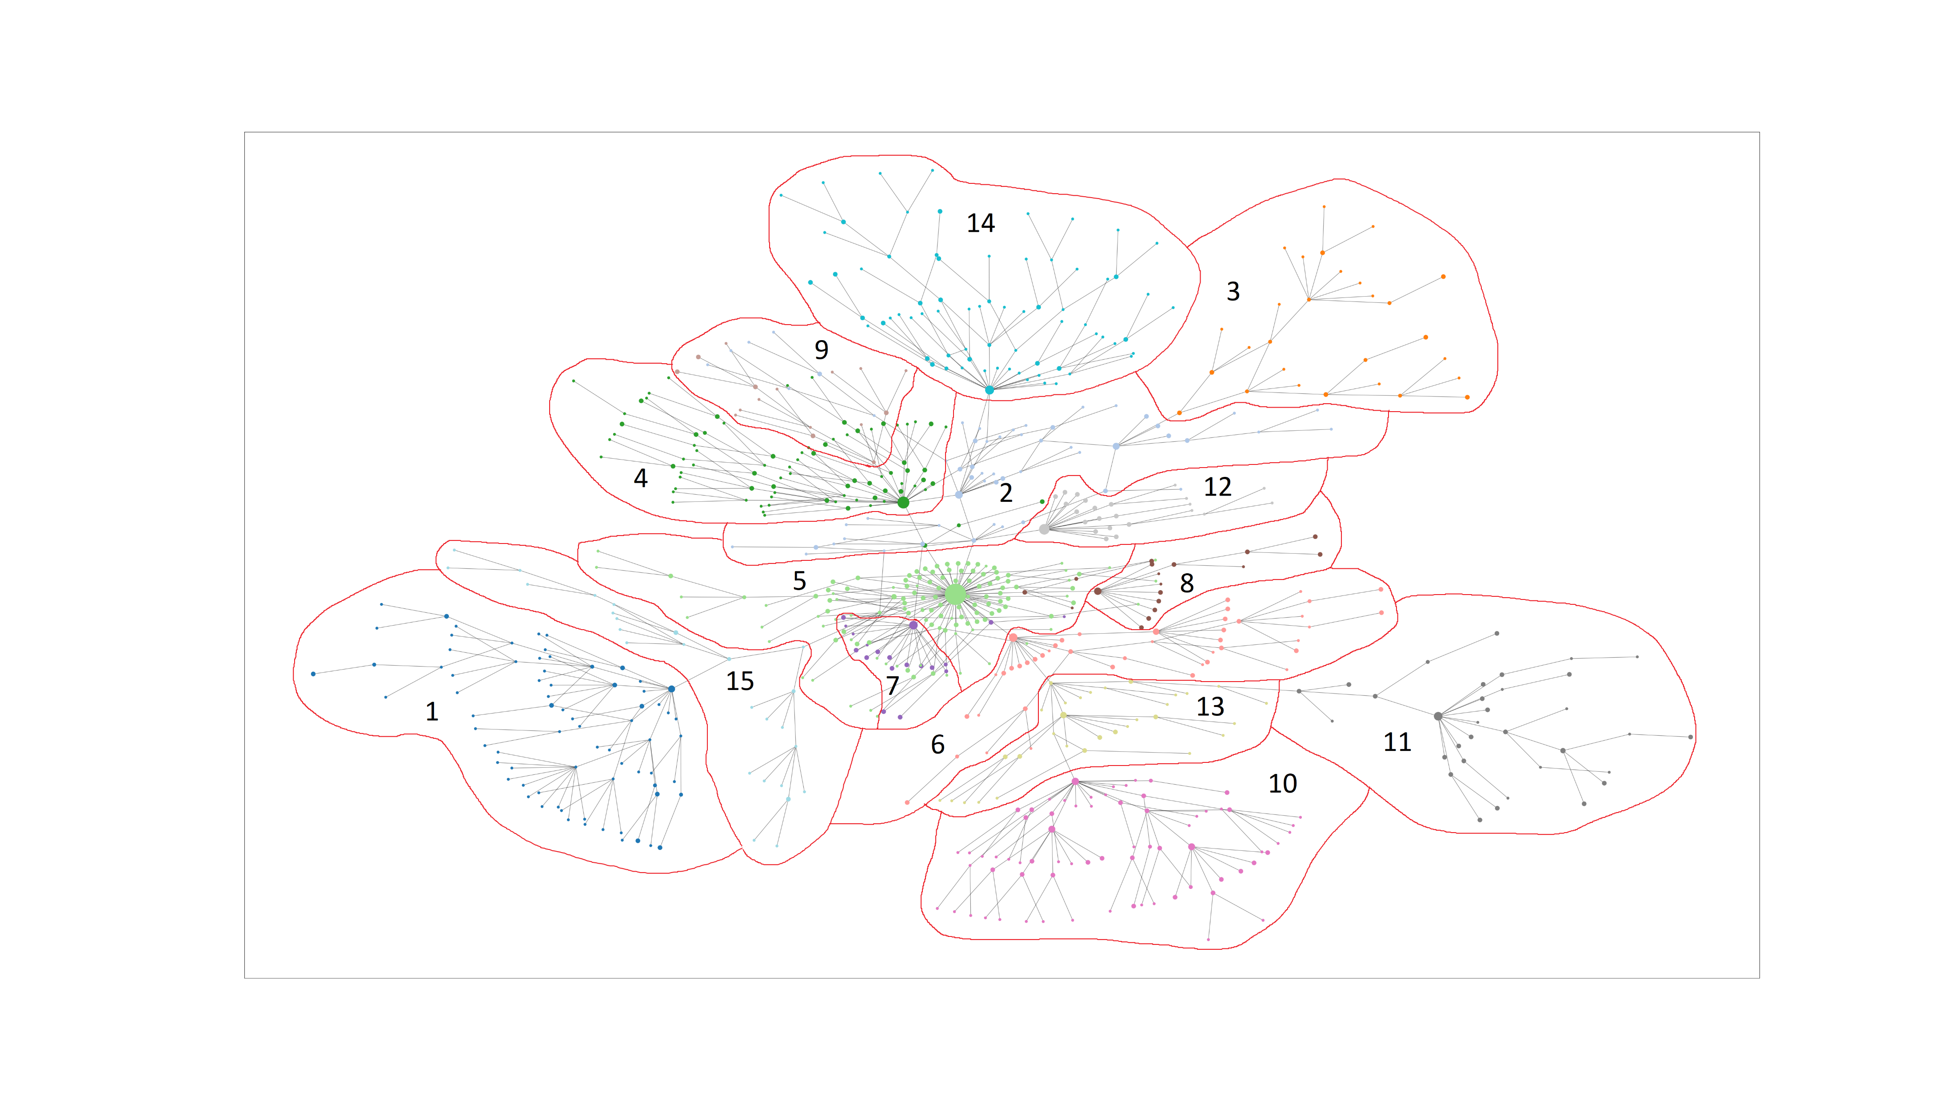
Community detection – Louvain 15 Clusters

